Slide 1
DIN TEXTILE MILLS LIMITED
Corporate Briefing Session 2023

Slide 2
DIN TEXTILE MILLS LIMITED
Contents
Introduction
Historical Financial Highlights
Future Outlook

Slide 3
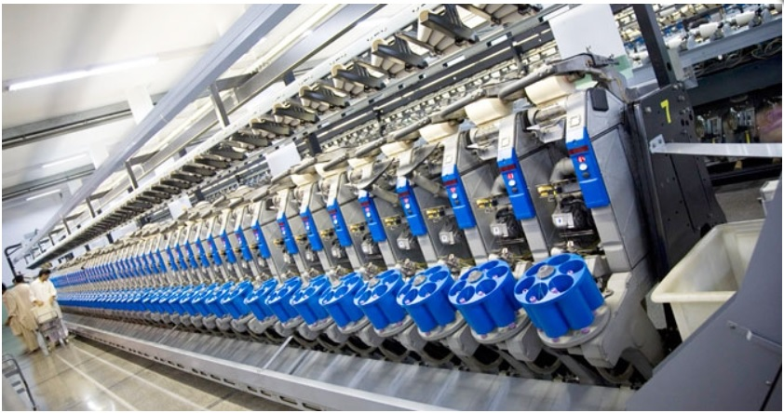
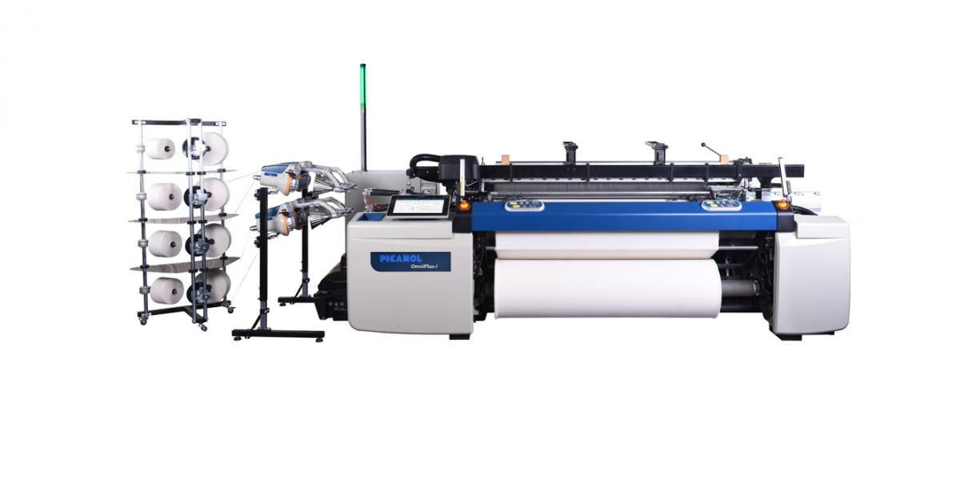
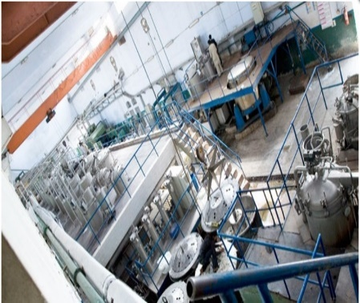
Introduction
Din Textile Mills Limited (DTML) is limited by shares, incorporated in Pakistan on June 13, 1988 and is quoted on Pakistan stock exchange (Formerly: Karachi Stock Exchange Limited). DTML is principally engaged in manufacturing and sales of yarn and Greige Fabrics.
134,928 Spindles
4 Spinning Units
1 Dyeing Unit 13 Ton /day
144 Air-Jet Looms
1 Weaving Unit

Slide 4
Historical Financial Highlights

Slide 5
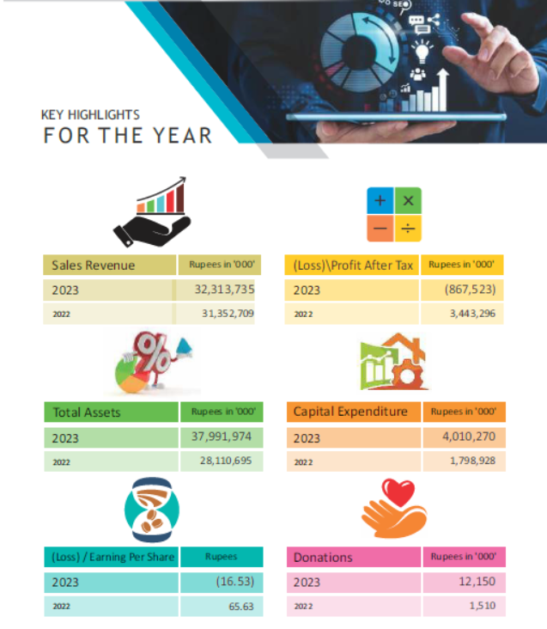
3%
125%
35%
223%
125%
804%

Slide 6
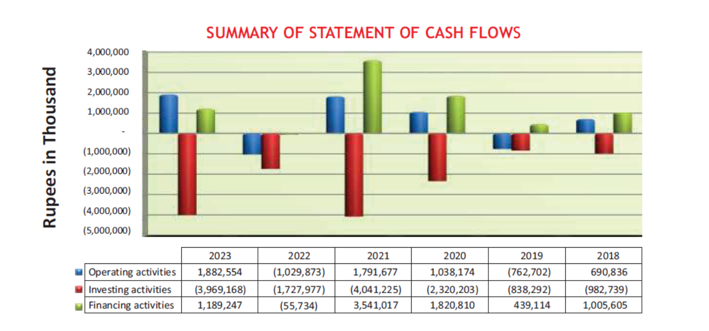

Slide 7
STATEMENT OF VALUE ADDED
WEALTH GENERATED | 2023 |  | 2022
 | Rupees | % | Rupees | %
Gross Sales Revenue | 32,661,044,692 | 99.43 | 31,645,876,872 | 99.6
Other Receipts | 187,214,398 | 0.57 | 126,472,842 | 0.4
Less: Material & services
Material & Factory cost | 26,688,843,188 | -81.25 | 23,059,330,818 | -72.58
Administrative & other | 208,396,743 | -0.63 | 123,669,990 | -0.39
Distribution | 470,566,053 | -1.43 | 306,503,114 | -0.96
Broker's Commissions | 347,309,799 | -1.06 | 293,167,847 | -0.92
Value Add | 5,133,143,307 | 15.63 | 7,989,677,945 | 25.15

Slide 8
STATEMENT OF VALUE ADDED

Slide 9
STATEMENT OF VALUE ADDED - CONTINUED
WEALTH DISTRIBUTED | 2023 |  | 2022
 | Rupees | % | Rupees | %
To Employees
Salaries & benefits | 1,786,149,524 | 34.80 | 1,663,201,574 | 20.82
To Government
Tax | 242,411,645 | 4.72 | 289,491,312 | 3.62
Worker Profit Participation fund | - | - | 200,497,724 | 2.51
Worker Welfare Fund | - | - | 76,189,135 | 0.95
To Providers of Capital
Mark up/Interest on Borrowed Fund | 3,013,394,602 | 58.70 | 1,388,924,178 | 17.38
To Provide for Maintenance & Expansion of Assets
Depreciation | 963,812,131 | 18.78 | 934,597,760 | 11.70
Profit Retained / (Loss) | (872,624,595) | (17.00) | 3,436,776,262 | 43.02
 | 5,133,143,307 | 100 | 7,989,677,945 | 100

Slide 10
STATEMENT OF VALUE ADDED

Slide 11
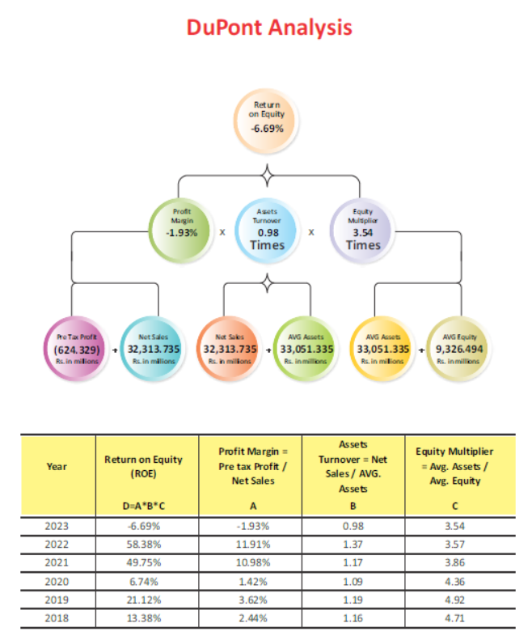

Slide 12
Rs. in Million

Slide 15
Textile Outlook
From $19.3 billion recorded in 2021-22, the level of textile exports from Pakistan fell by 15 percent to reach $16.5 billion in 2022-2023. Basic textiles recorded a 22% decline, while value-added products declined by 13% compared to the previous year. The slowdown in textile exports is attributed to the global recession, lower export orders, and challenges within the domestic environment. Challenges in the domestic economy include the removal of subsidies, unavailability of locally produced cotton, delays in the clearance of imported cotton and other essential inputs, elevated gas and electricity tariffs, and increased finance costs..
Market experts anticipate an increase in volumetric terms for textile exports as the inventory pileup gradually declines and demand resurges at export destinations. However, the decline in product prices is likely to offset the impact. Furthermore, headwinds in the domestic economy will continue to hamper textile players, further exacerbating the challenges faced by the industry.
Government is paying significant attention towards cotton growth by increasing sowing area as well as working on good quality cotton. It is expected that, these measures will have positive impact for textile sector and overall economy in coming days

Slide 16
Q & A Session

Slide 17
Thank you !

